Slide 1
Uganda’s Investment Environment
Martin Muhangi
Deputy Director, Investment Promotion Division
June 28, 2019

Slide 2
Outline
Mandate of Uganda Investment Authority
Uganda viable for business and investment
Investment opportunities
Attractive incentive regime
Government support/services

Slide 3
Mandate of Uganda Investment Authority
Coordinate, promote and facilitate investments
Develop and manage Industrial and Business Parks
Advise Government on Investment policy
Develop sustainable Domestic Investors and SMEs
Operationalize One Stop Service Centre
1
2
3
4
5

Slide 4
Why Uganda? Good for Business and Investment
Stable country over the past 20 years- "Under President Museveni, Uganda has experienced relative political stability, democratic progress, and economic growth." (Source: US Department of Commerce, 2017
Very strong economy. On average Uganda’s GDP growth rate has been over 6% for last 30 years
GDP growth forecasted at 6.1%

Slide 5
Why Uganda? Good for Business and Investment
Lowest crime rates and the most stable inflation rate in the EAC, averaging 4.89% from 2013-2017- (Source: World Bank)
Most open country in the region to Foreign Direct Investments with no restrictions on:
- Ownership of investments,
- Movements of capital,
- Foreign exchange.

Slide 6
Why Uganda? Good for Business and Investment
Attractive and competitive incentive regime
Market access

Slide 7
Gateway to Africa’s Largest Consumer Market
Centrally situated within East Africa
Uganda offers excellent access to markets in the EAC
One of the fastest growing regions of the world
Combined middle-class population of 30 million people - 20% are based in Uganda and 58% in Kenya
Uganda's location is unique in East Africa - shared borders and established trade links with South Sudan and DRC - dynamic frontier markets which are significant buyers of Ugandan products
Source: African Development Bank

Slide 8
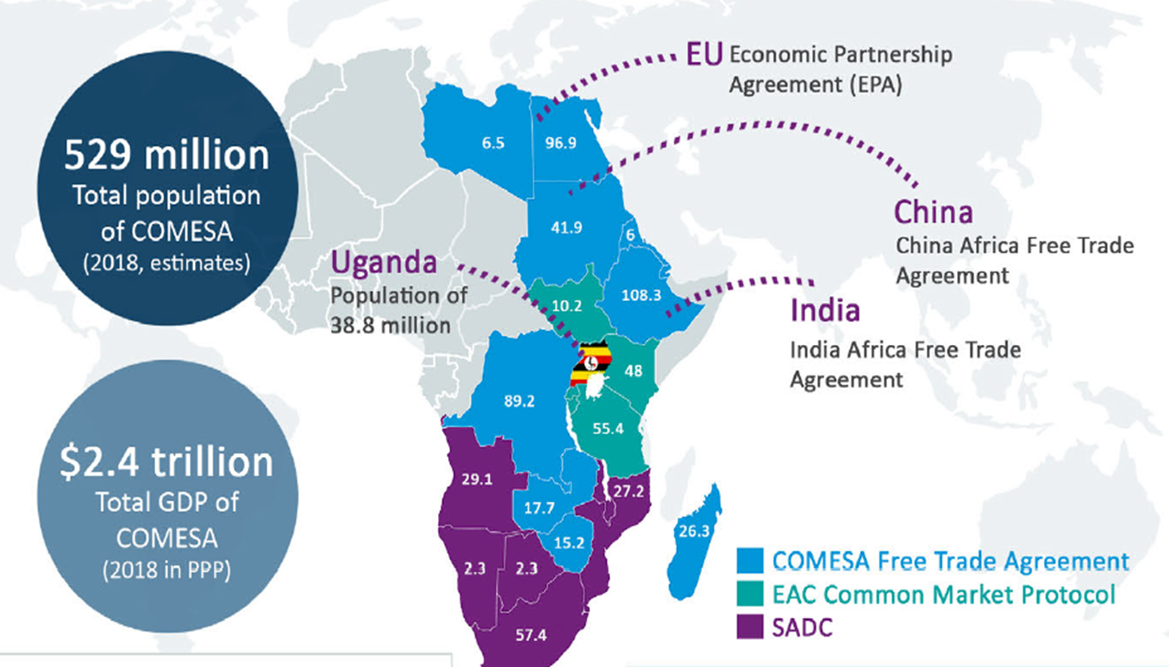

Slide 9
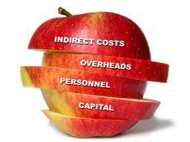
Why Uganda? Competitive Cost Drivers-Uganda
Labour
Power
Transport
Property Costs
Water
Notes:
Government support – Services under one stop Centre;
2.. Markets- Population growth and ability to pay

Slide 10
Labour
3rd globally in workforce deployment. (Source: World Economic Forum, Human Capital Index)
Lowest labour costs in the EAC region
Highest Adult literacy in East Africa- Literacy rate almost 90% for persons aged between 15-24. (Source: Knoema)
Fastest growing work force in the region

Slide 11
Labour growth rate
Source: fDi Benchmark from Financial Times

Slide 12
Utilities(Power and Water
Uganda’s electricity costs are competitive at 80 percent of Kenya’s costs. (Source: Fdi Benchmarks from Financial Times)
Average cost per Kwh for a large industrial user in 2019 is USD 0.085(Source: Umeme)
Price of water above 1000m3 for large industrial users is UGX. 2500/ USD. 0.68 Cents (Source: NWSC)

Slide 13
Transport
The Kampala Entebbe Expressway(51.4km) provides an efficient transportation route between Kampala Central Business District and Entebbe International Airport and forms a crucial part of Government’s overall strategy of decongesting the Greater Kampala Metropolitan area.
The Uganda road network comprises of 21,000km of national roads; 17,000km of district roads; 2,800km of urban roads and about 30,000km of community roads, connecting communities, districts. (Source Uganda Logistics Infrastructure).

Slide 14
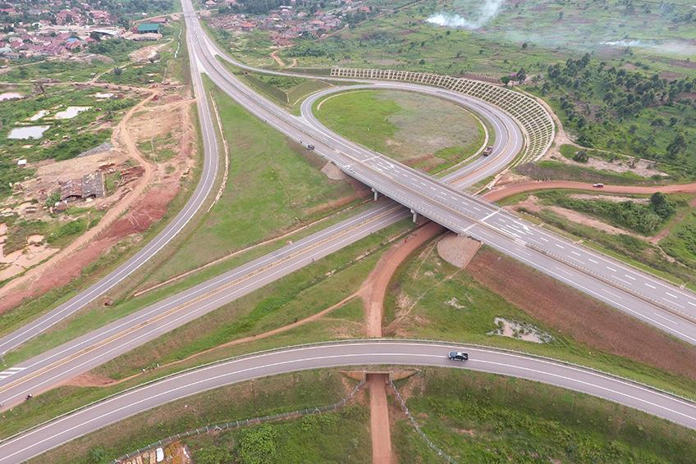

Slide 15
Property Costs
Property costs in Uganda are competitive with industrial shed monthly rents in the range of $4 - $6 per sq. m.
Source: Knight Frank, Local Property Agents

Slide 16
Priority Sectors for Investment
Agriculture and agro processing
Tourism
Mining and adding value to minerals
Oil and Gas
Information Communication Technology
Manufacturing

Slide 17
Agriculture and Agro-processing
Strong agribusiness sector with value added in agriculture accounting for 25% of Uganda’s GDP.
Source: (World Bank, World Bank Development indicators)
267 Companies involved in manufacturing of food and beverages.
Source: (Fdi Benchmarks from Financial Times, 2018)
Notes:
Uganda has a strong track in the production of agricultural products and is the most open trading country in the region

Slide 18
Food Sector Exports
Source: World Bank, World Development Indicators
Notes:
1. The data for Rwanda is for 2016

Slide 19
Merchandise exports to sub-Saharan.
Source: World Bank, World Development Indicators
Notes:
1. Uganda has the highest percentage of its exports to sub-Saharan Africa

Slide 20
Tourism
Tourism contributed to the GDP of Uganda amounting to UGX 6,888.5bn in 2017 (7.3% of GDP), up from UGX 6,171.5bn in 2016. (Source: Ministry of Tourism and Wildlife)
Opportunities:
High to Medium end accommodation along the Tourist circuits
Conservation areas
Water and Aviation Transport
Cultural Tourism / Facilities
Notes:
Uganda has a strong track in the production of agricultural products and is the most open trading country in the region

Slide 21
Minerals
Resources/ Potential
Opportunities
Gold
Iron ore- Over 200 million metric tonnes
Uranium
Tin
Non- metallic minerals
Graphite
Clays
Phosphates
Mining and processing plants
Establishment of mineral laboratories-Modern analytical equipment's.
Drilling rigs with drillers
Logistics
Over 50 mineral types exist in Uganda
Great need for iron and Steel for infrastructure projects
Notes:
The nature of mineral exports is in concentrates form without refining, which in the long run draws less foreign earnings for the economy. Therefore, this calls for value addition interventions

Slide 22
Oil and Gas
Value Chain Opportunities
“The Graben”
Licensing of petroleum exploration
Joint Ventures with companies in exploration
Waste Management and removal
Infrastructure development
Education and Training- (fabrication, electrical)
Rig hire
Oil Storage tanks
Logistics
Notes:
Companies are international certified for environmental management system and risk management procedures

Slide 23
Information Communication Technology
ICT
Certified training centers
Development of quality ICT infrastructure
ICT
Business Process Outsourcing
ICT
Soft ware development and services
Hardware manufacturing and Assembly
Uganda is ranked 15th in Africa in internet usage/penetration-42.9% of the population use internet.
Source: Internet world statistics 2019
Presence of different ICT associated companies like Huawei, Samsung, Apple, and Phillips enables digital innovations in Uganda.
Notes:
United Nations Economic Commission for Africa
Universal communication in the country and region
Challenges of cyber security
Uganda is growing with double digit growth every year in ICT

Slide 24
Benefits of investing in Uganda
Incentive Regime
Import duty exemption on Plant and Machinery
10 year income tax holiday for persons exporting more than 80% of their production outside the domestic market
Losses carried forward indefinitely till full exhaustion
100% training expenditure for Ugandan employees allowed
VAT deferment on imported plant and Machinery for registered persons 10 year tax holiday for Ugandan Citizen who invests USD 1 million and processes agricultural goods

Slide 25
Ease in doing business- UIA Reforms
Incorporation of company- 4hrs
Tax registration less than 24hrs.
Permits/licenses Issued at One Stop Centre
Online services available for investment License
Key achievements
Improved Business Environment
Online
One Stop
Centre
24/7
www.ebiz.go.ug

Slide 26
One Stop Centre Services
In order to ease business and improve efficiency, UIA is a One Stop Centre (OSC) for business registration, licensing and accessing investor relevant services.
Uganda Investment Authority (Investment promotion, facilitation and monitoring)
Business Registration (URSB)
Tax Advisory & registration (URA)
Immigration (DCIC)
Environmental Advice & Compliance (NEMA)
Standards Certification
(UNBS)
Lands verification (Lands Registry)
Utility Providers (NWSC and Umeme)
Trade registration and building approval in Kampala (KCCA)
Free Zones (UFZA)
Banking Facilities (DTB)
Conservation Tourism Opportunities (Space for Giants)
Notes:
The various services offered by different government institutions under one roof. Zero cost on movement and Minimal time on processing

Slide 27
Services at UIA
Providing Information on investment opportunities
Issuing Investment Licenses
Assisting in Securing Secondary Approvals
Finding Joint Venture Partners
One Stop Centre

Slide 28
Services at UIA
Handholding Investors through all procedures
Providing access to land for investment
Development and supporting Small and Medium Enterprises
Policy Advocacy - Policies affecting investment.

Slide 29
Conclusion
“Risk comes from not knowing what you're doing.”
Warren Buffet

Slide 30
Invest now…..Invest in Uganda
Thank You
Email: info@ugandainvest.go.ug
Website: www.ugandainvest.go.ug
Tel: +256 313 301000 / 301100
www.ebiz.go.ug

